Slide 1



DIYALA UNIVERSITY
COLLEGE OF ENGINEERING
DEPARTMENT OF COMMUNICATIONS ENGINEERING
Mathematics- II
$$7^{th }Lecture$$
First Year
lecturer
Wisam Hayder
2021

Slide 2
VECTOR-VALUED FUNCTIONS AND
MOTION IN SPACE
Curves in Space and Their Tangents
When a particle moves through space during a time interval I, we think of the particle’s coordinates as functions defined on I:
The points make up the curve in space that we call the particle’s path. The equations and interval in Equation (1) parametrize the curve.
A curve in space can also be represented in vector form. The vector

Slide 3
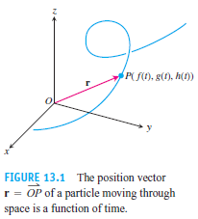
VECTOR-VALUED FUNCTIONS AND
MOTION IN SPACE
From the origin to the particle’s position P(ƒ(t), g(t), h(t)) at time t is the particle’s position vector (Figure 13.1). The functions ƒ, g, and h are the component functions (components) of the position vector.
Equation (2) defines r as a vector
function of the real variable t on the
interval I. More generally, a vector
-valued function or vector function
on a domain set D is a rule that
assigns a vector in space to each
element in D. For now, the domains
will be intervals of real numbers
resulting in a space curve.

Slide 4
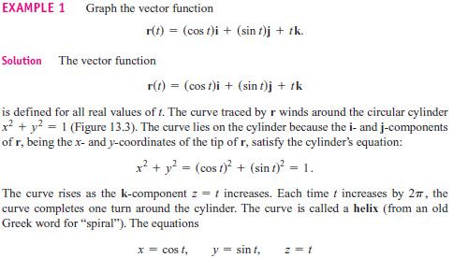
VECTOR-VALUED FUNCTIONS AND
MOTION IN SPACE
Real-valued functions are called scalar functions to distinguish them from vector functions. The components of r in Equation (2) are scalar functions of t. The domain of a vector-valued function is the common domain of its components.
Notes:
aaa

Slide 5
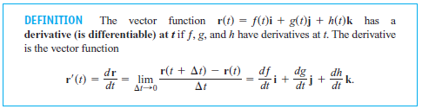
VECTOR-VALUED FUNCTIONS AND
MOTION IN SPACE
Derivatives and Motion
A vector function r is differentiable if it is differentiable at every point of its domain.
The curve traced by r is smooth if dr/dt is continuous and never 0, that is, if ƒ, g, and h have continuous first derivatives that are not simultaneously 0.

Slide 6
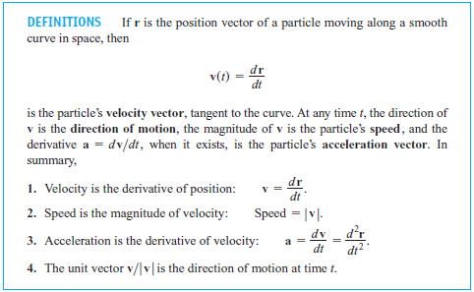
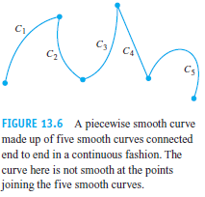
VECTOR-VALUED FUNCTIONS AND
MOTION IN SPACE
Notes:
aaa

Slide 7
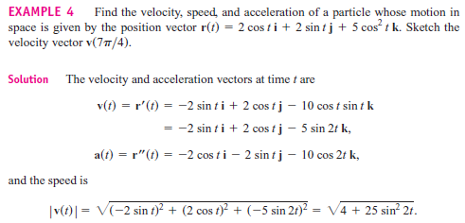
VECTOR-VALUED FUNCTIONS AND
MOTION IN SPACE
Notes:
aaa

Slide 8
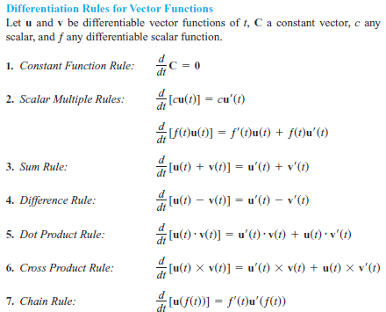
VECTOR-VALUED FUNCTIONS AND
MOTION IN SPACE
Differentiation Rules

Slide 9

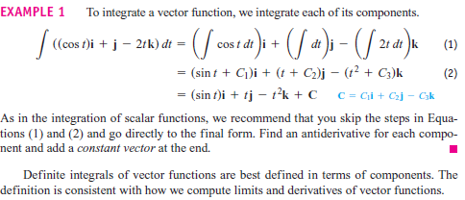
VECTOR-VALUED FUNCTIONS AND
MOTION IN SPACE
Integrals of Vector Functions; Projectile Motion
Integrals of Vector Functions

Slide 10

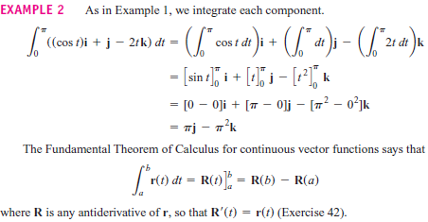
VECTOR-VALUED FUNCTIONS AND
MOTION IN SPACE
Notes:
aaa

Slide 11

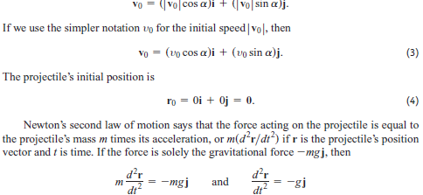
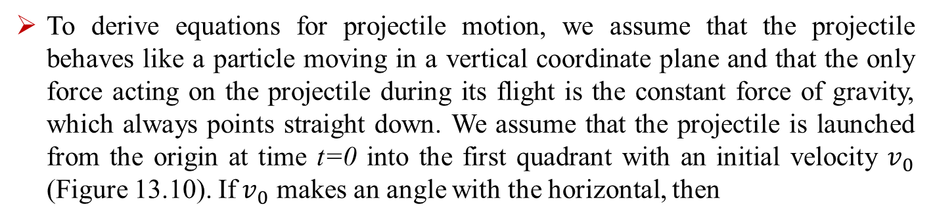
The Vector and Parametric Equations for Ideal Projectile Motion
To derive equations for projectile motion, we assume that the projectile behaves like a particle moving in a vertical coordinate plane and that the only force acting on the projectile during its flight is the constant force of gravity, which always points straight down. We assume that the projectile is launched from the origin at time t=0 into the first quadrant with an initial velocity $v_{0}$ (Figure 13.10). If${ v}_{0}$ makes an angle with the horizontal, then

Slide 12

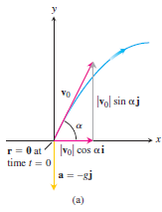
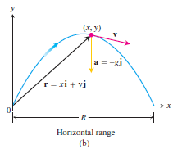
VECTOR-VALUED FUNCTIONS AND
MOTION IN SPACE
FIGURE 13.10 (a) Position, velocity, acceleration, and launch angle at (b) Position, velocity, and acceleration at a later time t.
Notes:
aaa

Slide 13
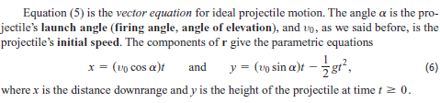
VECTOR-VALUED FUNCTIONS AND
MOTION IN SPACE
Notes:
aaa

Slide 14
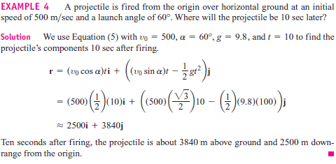
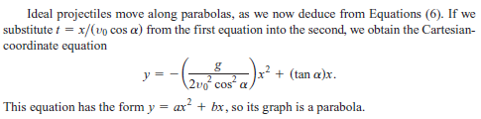
VECTOR-VALUED FUNCTIONS AND
MOTION IN SPACE
Notes:
aaa

Slide 15
VECTOR-VALUED FUNCTIONS AND
MOTION IN SPACE
A projectile reaches its highest point when its vertical velocity component is zero.
When fired over horizontal ground, the projectile lands when its vertical component equals zero in Equation (5), and the range R is the distance from the origin to the point of impact.

Slide 16
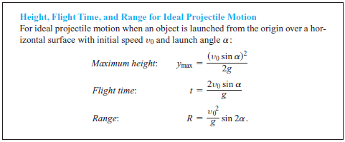
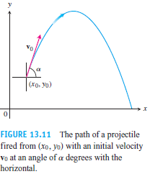

VECTOR-VALUED FUNCTIONS AND
MOTION IN SPACE

Slide 17
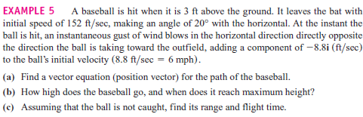
VECTOR-VALUED FUNCTIONS AND
MOTION IN SPACE
The next example shows how to account for another force acting on a projectile, due to a gust of wind. We also assume that the path of the baseball in Example 5 lies in a vertical plane.

Slide 18
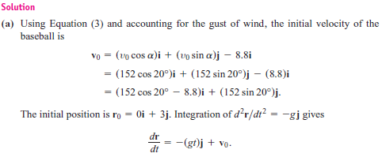
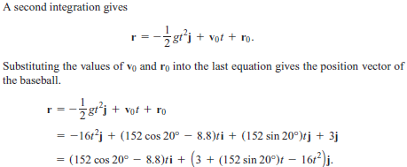
VECTOR-VALUED FUNCTIONS AND
MOTION IN SPACE

Slide 19


VECTOR-VALUED FUNCTIONS AND
MOTION IN SPACE
(b) The baseball reaches its highest point when the vertical component of velocity is zero, or
Solving for t we find
Substituting this time into the vertical component for r gives the maximum height
That is, the maximum height of the baseball is about 45.2 ft, reached about 1.6 sec after leaving the bat.
(c) To find when the baseball lands, we set the vertical component for r equal to 0 and
solve for t:
The solution values are about t=3.3 sec and t=-0.06 sec Substituting the positive time into the horizontal component for r, we find the range
R = (152 cos 20° - 8.8)(3.3) = 442 ft .
Thus, the horizontal range is about 442 ft, and the flight time is about 3.3 sec.

Slide 20
VECTOR-VALUED FUNCTIONS AND
MOTION IN SPACE
Arc Length Along a Space Curve
One of the features of smooth space and plane curves is that they
have a measurable length.
This enables us to locate points along these curves by giving their
directed distance s along the curve from some base point,
the way we locate points on coordinate axes by giving their
directed distance from the origin (Figure 13.12).
This is what we did for plane curves in Section 11.2.
To measure distance along a smooth curve in space,
we add a z-term to the formula we use for curves in the plane.

Slide 21
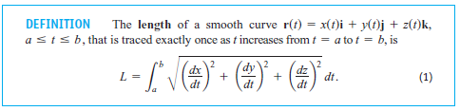
VECTOR-VALUED FUNCTIONS AND
MOTION IN SPACE

Slide 22

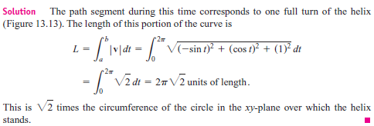
VECTOR-VALUED FUNCTIONS AND
MOTION IN SPACE
EXAMPLE 1 A glider is soaring upward along the helix r(t)=(cos t)i + (sin t)j + tk How long is the glider’s path from t = 0 to t = 2π?

Slide 23

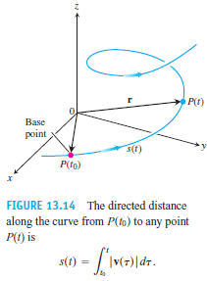
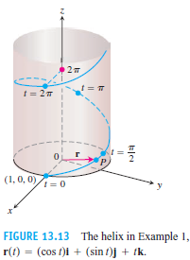
VECTOR-VALUED FUNCTIONS AND
MOTION IN SPACE

Slide 24
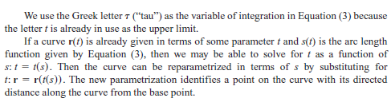
VECTOR-VALUED FUNCTIONS AND
MOTION IN SPACE

Slide 25
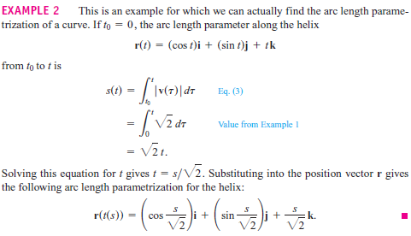
VECTOR-VALUED FUNCTIONS AND
MOTION IN SPACE

Slide 26

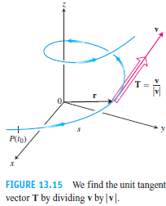
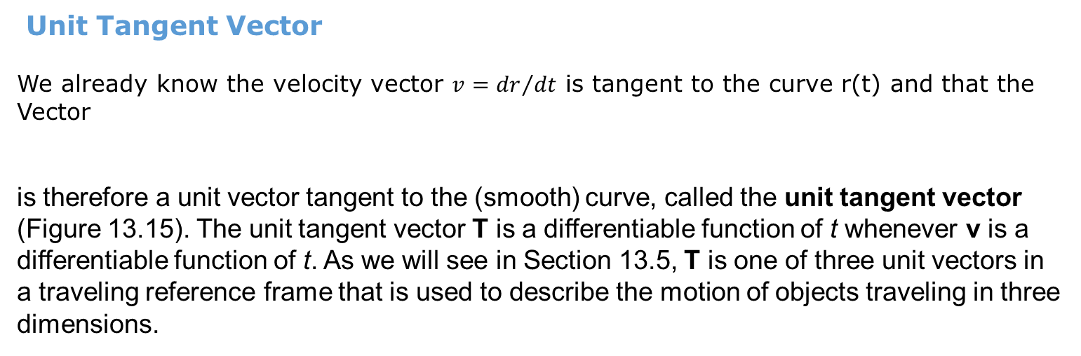
VECTOR-VALUED FUNCTIONS AND
MOTION IN SPACE
Unit Tangent Vector
We already know the velocity vector $v={dr}/{dt}$ is tangent to the curve r(t) and that the
Vector
is therefore a unit vector tangent to the (smooth) curve, called the unit tangent vector
(Figure 13.15). The unit tangent vector T is a differentiable function of t whenever v is a
differentiable function of t. As we will see in Section 13.5, T is one of three unit vectors in
a traveling reference frame that is used to describe the motion of objects traveling in three
dimensions.

Slide 27
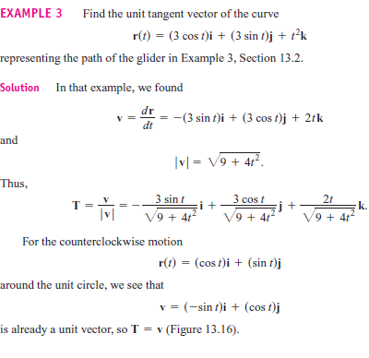
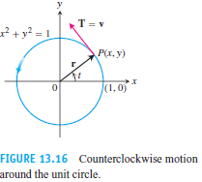
VECTOR-VALUED FUNCTIONS AND
MOTION IN SPACE

Slide 28
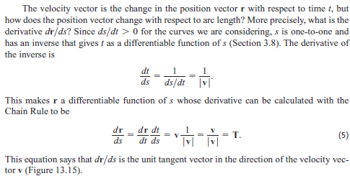
VECTOR-VALUED FUNCTIONS AND
MOTION IN SPACE

